Slide 1
NATIONAL Pygmy Hippo Day Celebration
THEME: TALK TO SOMEONE ABOUT PYGMY HIPPOS
APRIL 8, 2022
JERRY C. GARTEH
SCIENCE and CONSERVATION COORDINATOR
SOCIETY FOR THE CONSERVATION OF NATURE OF Liberia
Email: jgarteh@scnlliberia.org/jerry.garteh@gmail.com
Tel: 0770378476/0886610389

Slide 2
MESSAGE
They are in small population
You can only see them in the wild around
Do not kill it for bushmeat
Do not destroy the habitat
Do not set trap for Pygmy Hippo

Slide 3
Background of the day celebration
National Pygmy Hippo Day is created to raise awareness about the species, which has been classified as an endangered species. The Zoological Society of London deemed this to be the case, estimating that there are only roughly 2,000 of these species left in the wild today. This is a small number, and it is declining.
There are a number of reasons for the decline in the number of pygmy hippos today. This includes that they are being hunted for bushmeat and their natural habitats are being destroyed. There used to be a subspecies of pygmy hippos in Nigeria, but it is believed that these are now extinct, as there have not been any sightings for decades now.
The threat to this species is a very real one, and so it is important that we take note of National Pygmy Hippo Day so that we can do everything in our power to protect these wild animals that need our help!

Slide 4
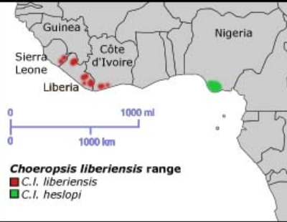

Slide 5
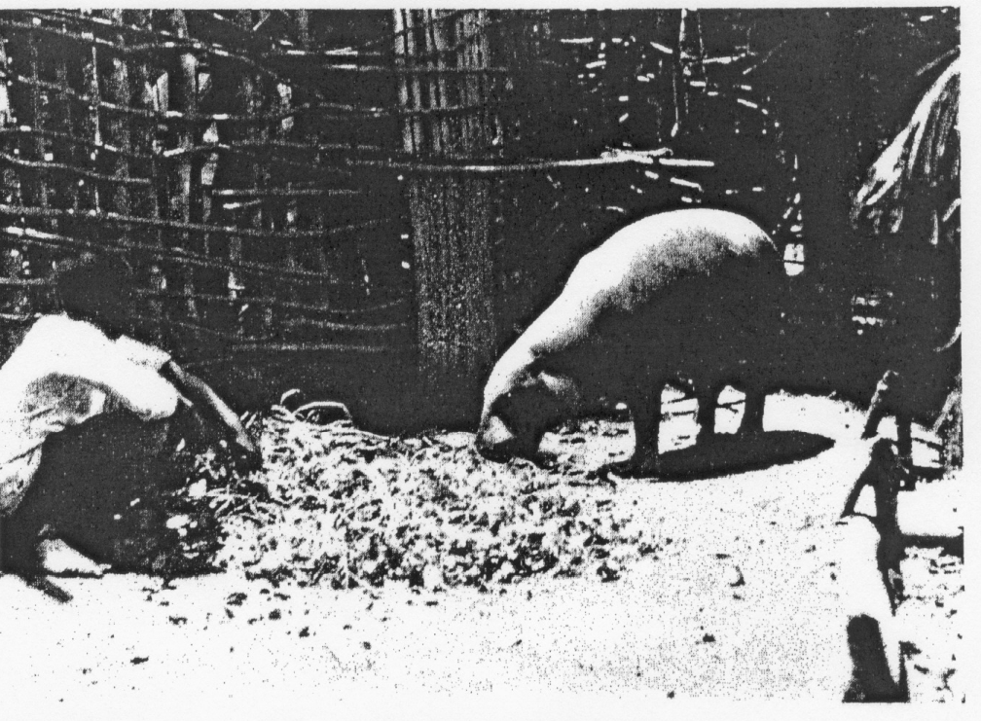
First PYGMY caught in the wild1911 and 1912

Slide 6
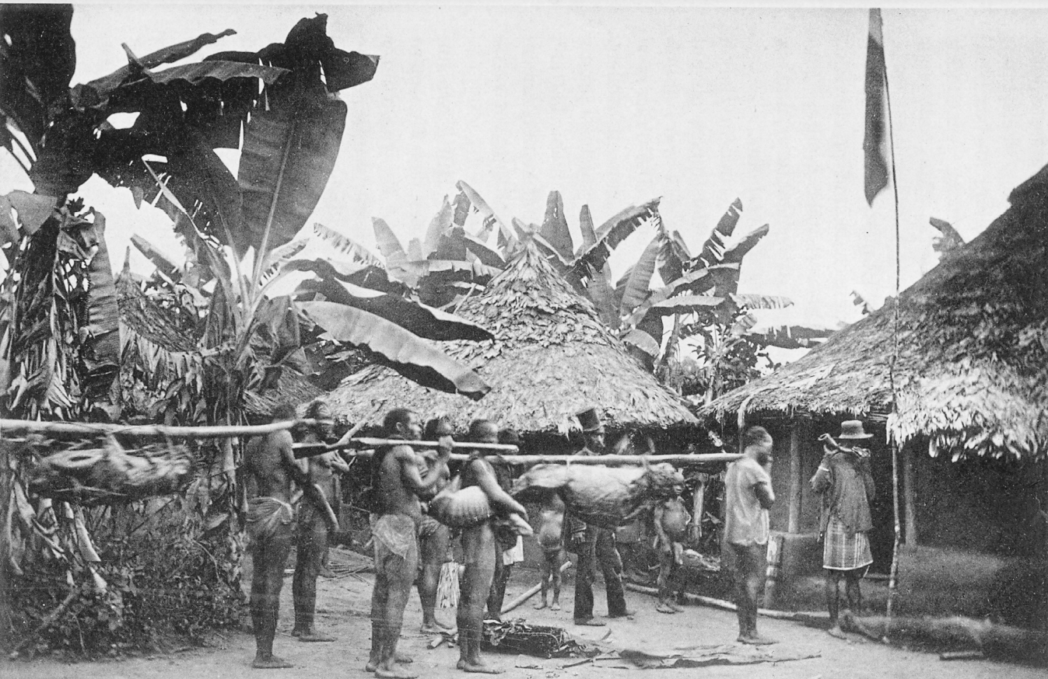
How Pygmy was hunted and taking away

Slide 7
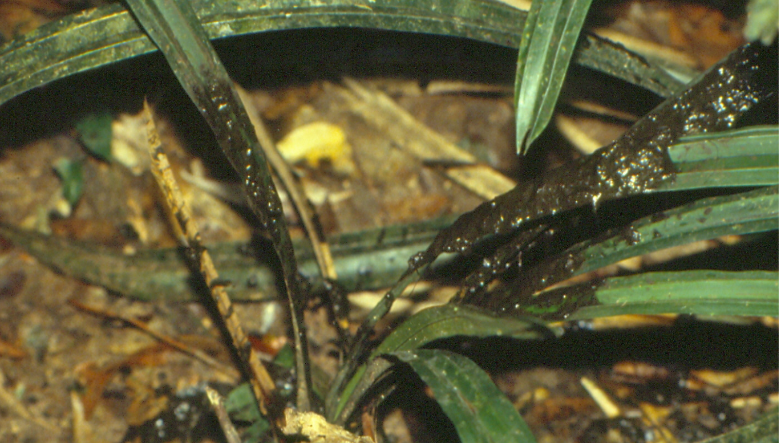
Know Pygmy Hippo
Body weight in the wild: Up to 2000kg Body weight in captivity: Males: 1800 - 2300kg Females: 1500 - 2100kg

Slide 8
Know Pygmy Hippo for yourselves
pygmy hippopotamus (Choeropsis liberiensis)
Endangered on the IUCN Redlist
Live in forest and swamp
Only from the forest in west Africa
The population of Pygmy Hippo is mainly in Liberia
The pygmy hippo is reclusive and nocturnal
Population 2000 pygmy hippos remain in the wild.
male pygmy hippopotamus is known as a bull, a female as a cow, and a baby as a calf

Slide 9
PYGMY HIPPO IN CAPTIVITY
First exported from Africa-------1973 from Liberia to Dublin, Ireland
Second reported live export– 1912 from Liberia to Germany (Hagenbeck Expedition
Three animals exported from Cape Mount, Liberia: one remained in Germany and a pair was sent to New York Zoological Societ
Body weight in the wild: Up to 2000kg Body weight in captivity: Males: 1800 - 2300kg Females: 1500 - 2100kg

Slide 10
REPRODUCTION
Reproduction Birth weight in captivity: 64.5kg (44 - 91kg)
Gestation length in captivity: 479.1 days (425-496 days)
Oestrus cycle in captivity: 30-45 days
Interbirth interval in the wild: 34 - 50 months
Interbirth interval in captivity: 32.6 months
Sexual maturity: Females: 4 – 6 years Males: 7 – 10 years
First reproduction in captivity: Male of known age: 6 years, 3 months, 24 days Female: 4 years and 7 days

Slide 11
THANK YOU FOR LISTENING

