Slide 1
Ribbit
“Shazam para sapos”
“¡Shazam para ranas!”
“شازام للضفادع”
An app for automated frog species identification and classification
“Shazam for frogs!”
Notes:
Hello everyone, today we’re going to talk about Ribbit, an app for automated frog species identification and classification, focused on reducing the biodiversity data gap in the Global South.

Slide 2
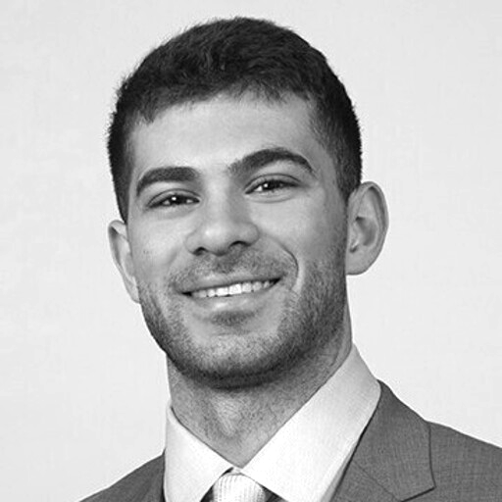
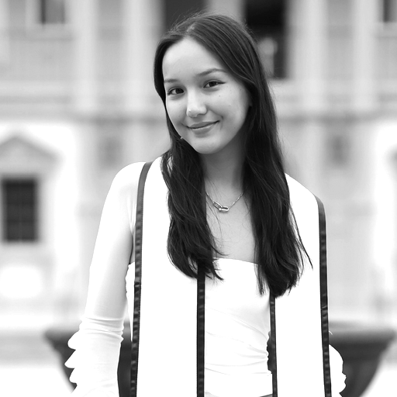
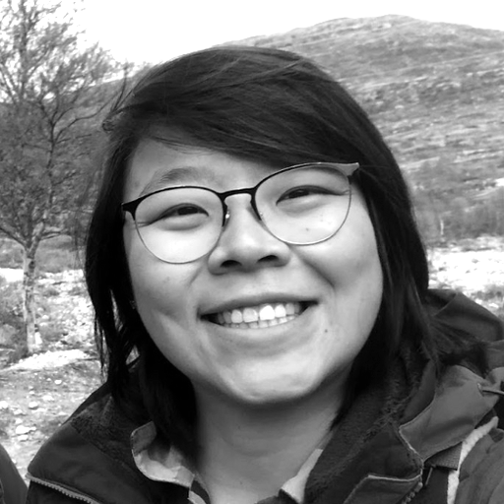
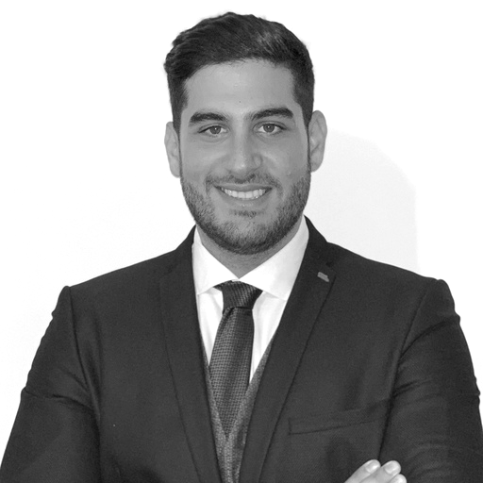
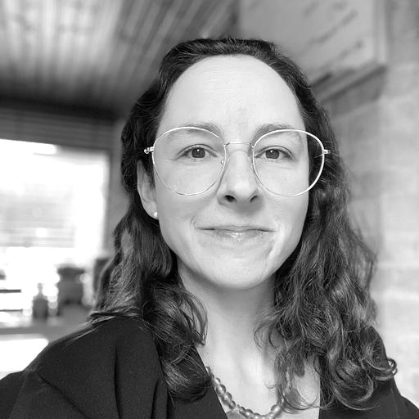
Farouk
Ghandour
Data engineer
Lia
Cappellari
Modeling lead
Erica
Nakabayashi
ML engineer
Haissam
Akhras
MVP lead
Juliana
Gómez Consuegra
PM - SME
Modeling
MVP
Product manager
Notes:
Our team is made up of Farouk our data engineer, Lia our modeling lead, Erica our ML engineer, Haissam our MVP lead, and myself, the product manager and subject matter expert.

Slide 3
01
Problem
Data gaps in the global south complicate conservation policy decisions
Notes:
The problem we’re trying to tackle is data gaps in the global south, which complicate conservation policy decisions. That is, deciding which areas to conserve and restore.

Slide 4
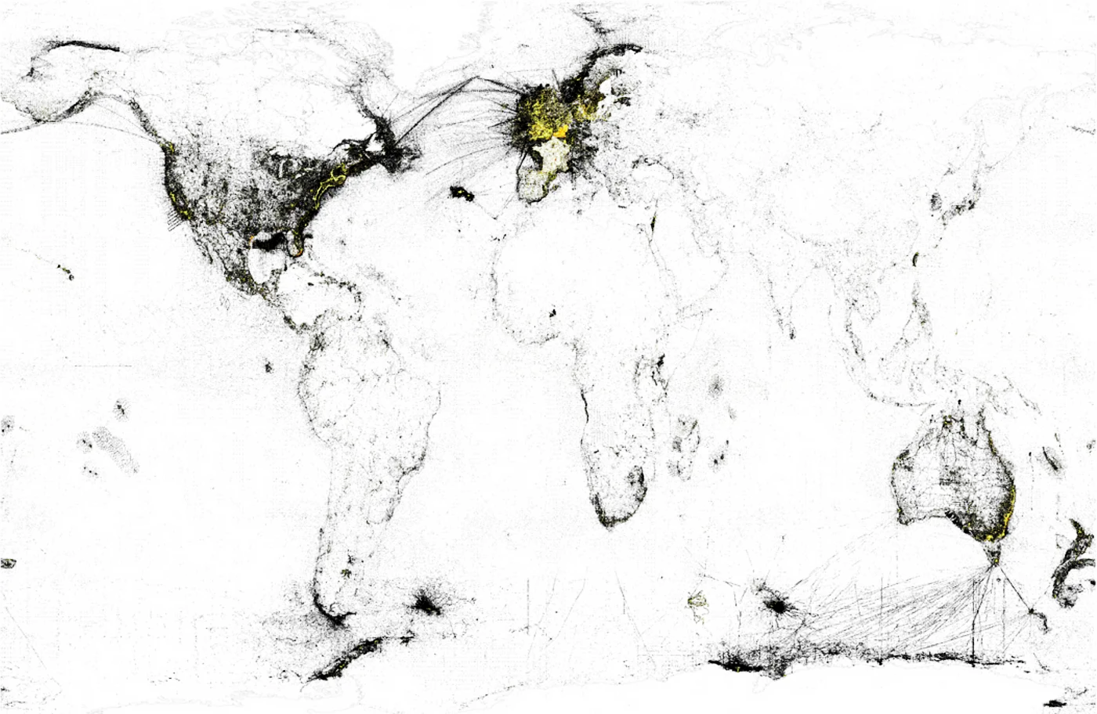
The biodiversity data gap
Low data
Medium data
High data
Geographical bias in major biodiversity databases (GBIF & OBIS records, Hughes et al., 2021)
Notes:
There is a bias towards data collection in the Global North, as shown by the black and yellow regions on this map.

Slide 5
Biodiversity hotspots
20%
15%
Hotspots
94%
66%
Loss
55%
Adapted from: https://databasin.org/maps
Notes:
But, the Global South has more biodiversity hotspots: that is, places that are both biologically rich and deeply threatened.
This generates an opportunity to increase the amount of data collected in these countries.
To reach more people in the Global South, we’ve made our product available in four languages: English, Spanish, Portuguese and Arabic.

Slide 6
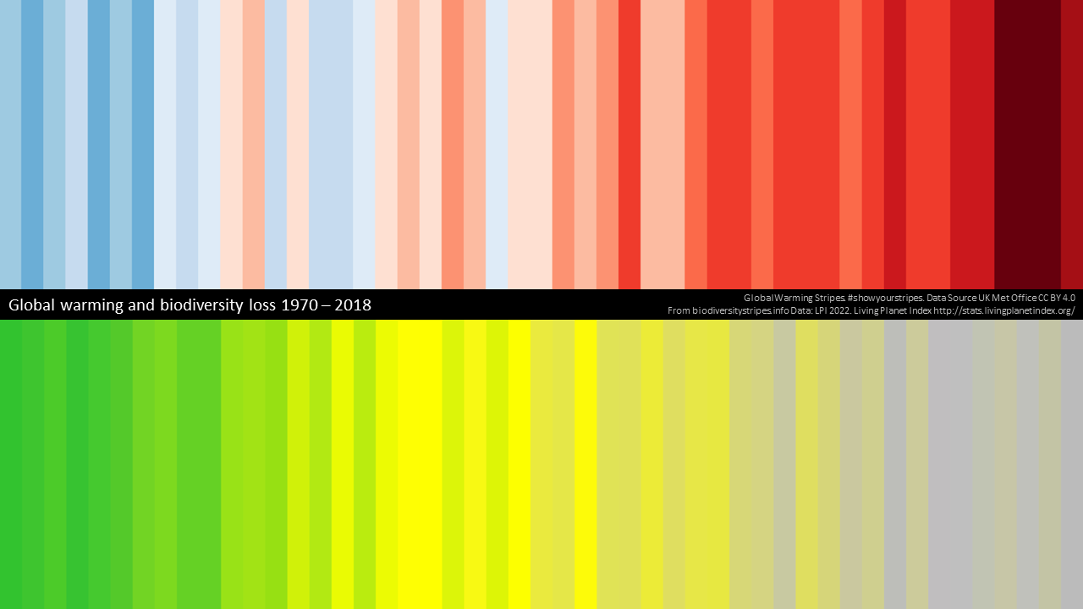
Why frogs?
Amphibians are one of the most endangered vertebrate groups in the world, with more than 40% of the
species endangered to extinction
(Cañas et al., 2023)
https://biodiversitystripes.info/globalbiowarming
Notes:
So, why frogs? Because they’re one of the world’s most endangered vertebrate groups, partly due to climate change.
As you can see on this image on the right: the warmer it gets (red stripes at the top), the fewer the species (grey stripes at the bottom).

Slide 7
02
Market research & target users

Slide 8
Primary Users and Use Case
Nature Enthusiasts
Researchers and Conservationists
Institute Stakeholders
Use Case: Record and classify frog species, and optionally contribute data to global biodiversity repositories
Communities like Wildlabs.net
Coworkers, friends, family…anybody interested in nature
Ecuador
Colombia
Spain
We have been in contact with members from the following:
Humboldt Institute of Biodiversity
Javeriana University in Colombia
Notes:
Our primary users for our project include nature enthusiasts, researchers and conservationists, and institute stakeholders that we have been in contact with. Our primary use case is to record and classify frog species with the option to contribute data to global biodiversity repositories for conservation efforts.

Slide 9


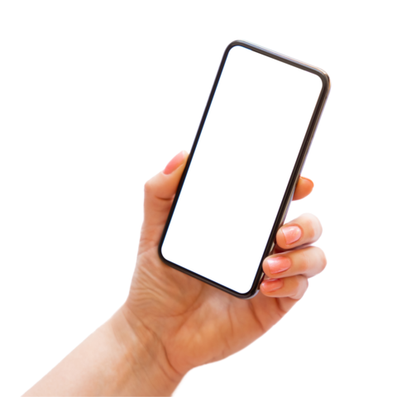
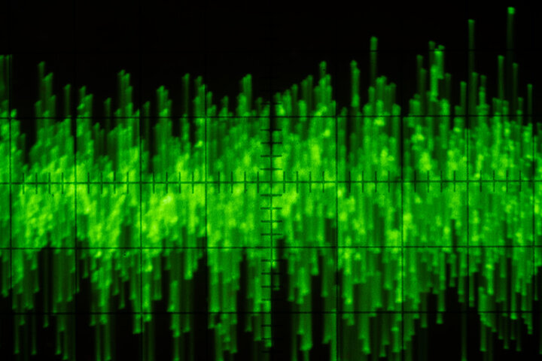
Who’s working on this?
Notes:
Already in the field there are a couple of different biodiversity monitoring platforms such as Merlin and iNaturalist. However, neither of these offer much insight into amphibians. Our project aims to fill this gap by developing a web interface for real-time species identification. By adapting a pretrained model and employing few-shot learning techniques, we will leverage spectrogram embeddings tailored for the classification of frog species.

Slide 10
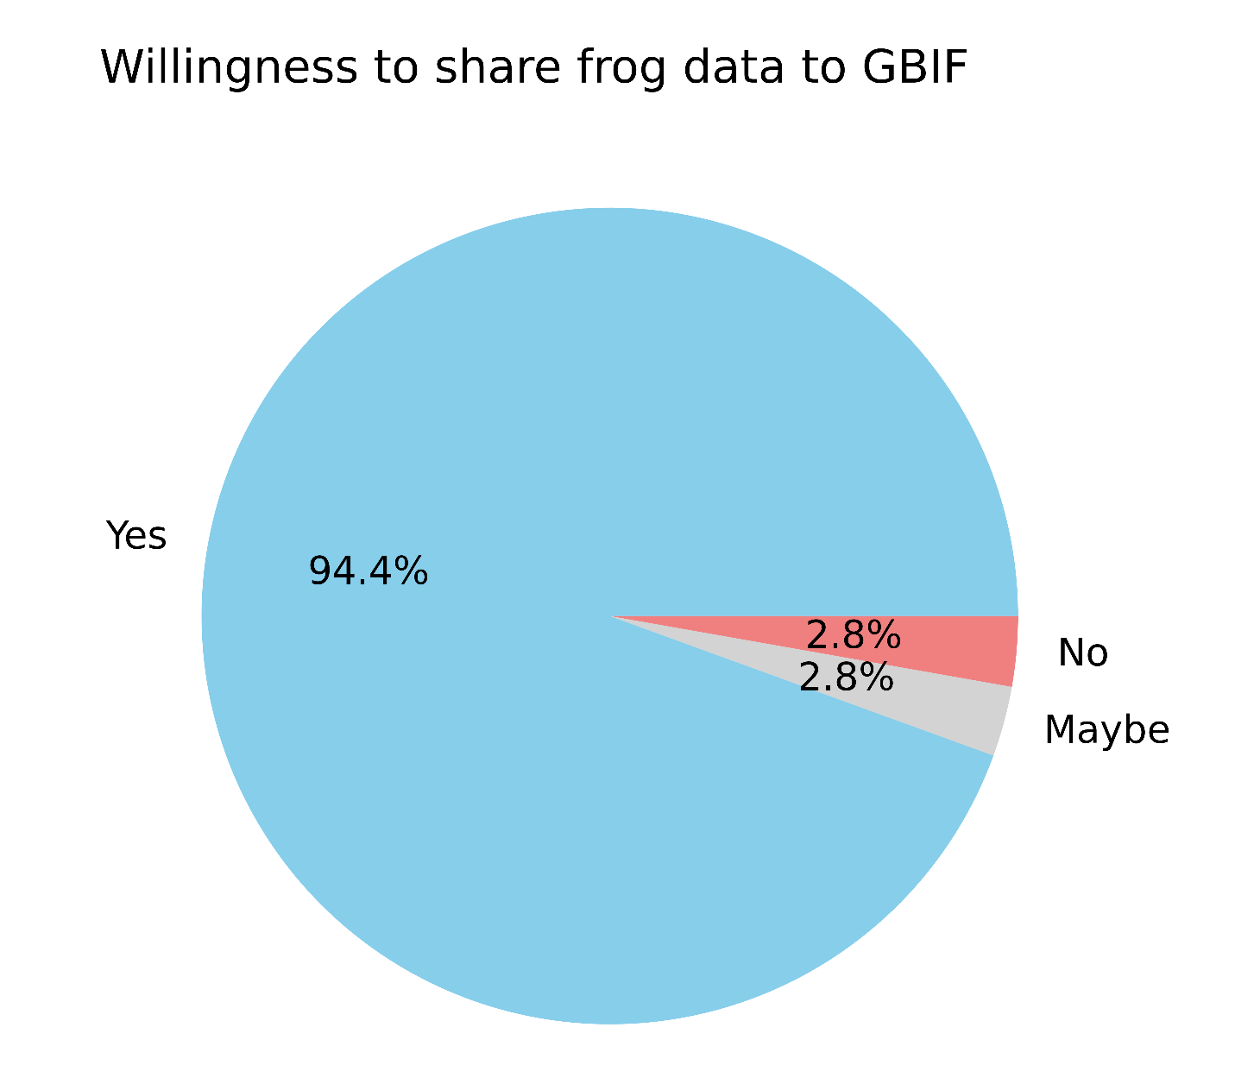
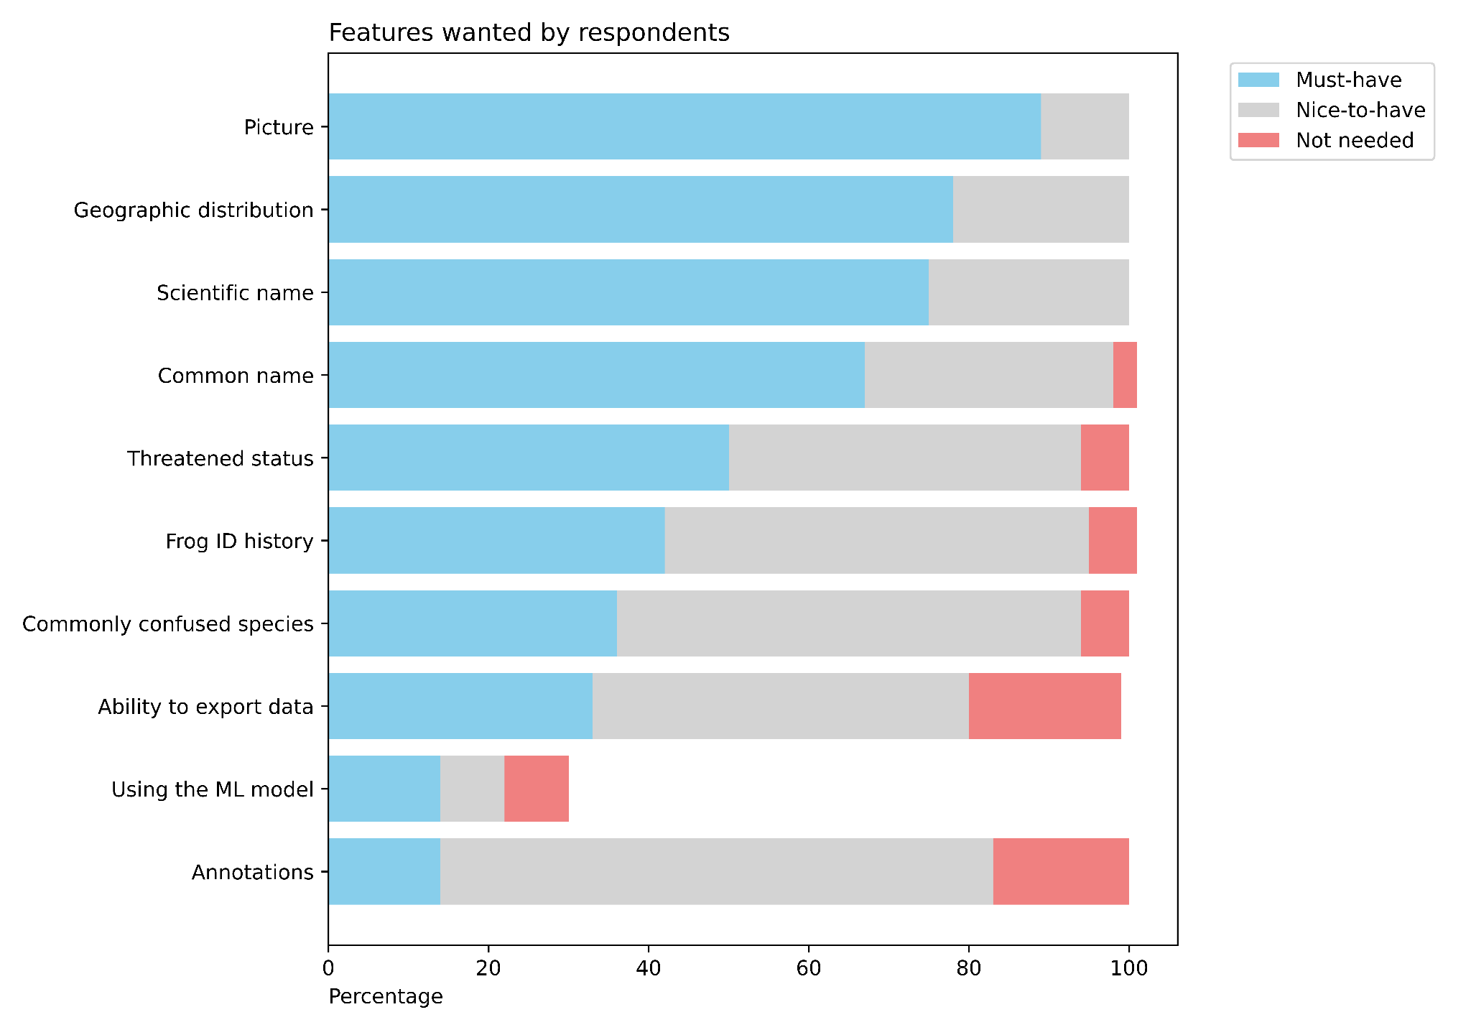
Learning from Potential Users
Survey → 87 responses
44 Spanish, 27 English, 16 Portuguese
45 left contact information for beta testing
Notes:
We reached out to a few of our contacts and shared a survey. 45 of them agreed to be contacted for beta testing, which we just sent out. On the left you can see that about 94% said they are willing to share their data for conservation efforts. And the right shows 10 possible features we were thinking to include and how necessary users think they are.

Slide 11
03
Data

Slide 12
Data
AnuraSet
iNaturalist
Anfibios del Ecuador
67,296 Total Calls
Vanilla Models
FSL Models
43 Species
71 Species
23 Families
100 calls/class
35 calls/class
Notes:
We originally had 3 datasets, however, we were only able to use the data from two of those, Anuraset and iNaturalist. After filtering out species with insufficient data, we ended up with around 67,000 calls. We decided to use two different modeling techniques, a normal vanilla multiclass model which used 43 species, and few shot learning models on 72 species and 23 families.

Slide 13
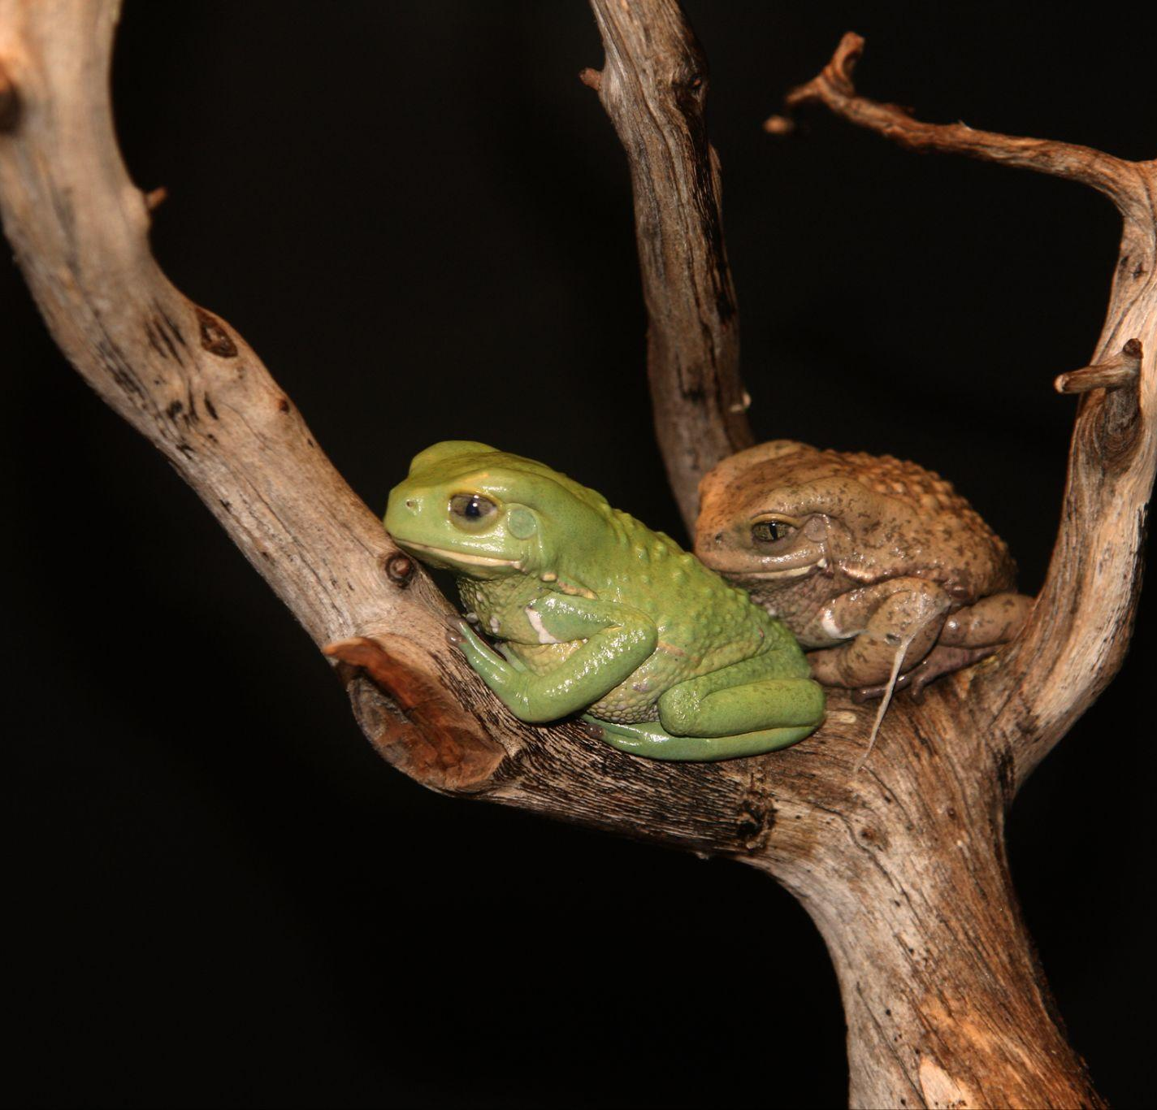
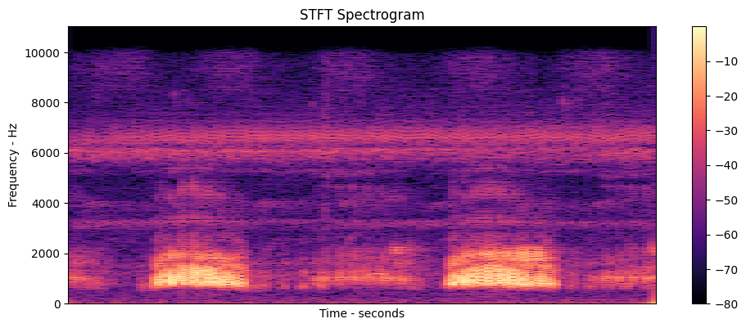

What our frogs sound like
What a frog call sounds like:
And what it looks like:
By Brocken Inaglory - Own work, CC BY-SA 3.0, https://commons.wikimedia.org/w/index.php?curid=7798416
Notes:
We analyzed our calls, transforming them from sounds to images, as we will be using CNNs in our modeling

Slide 14
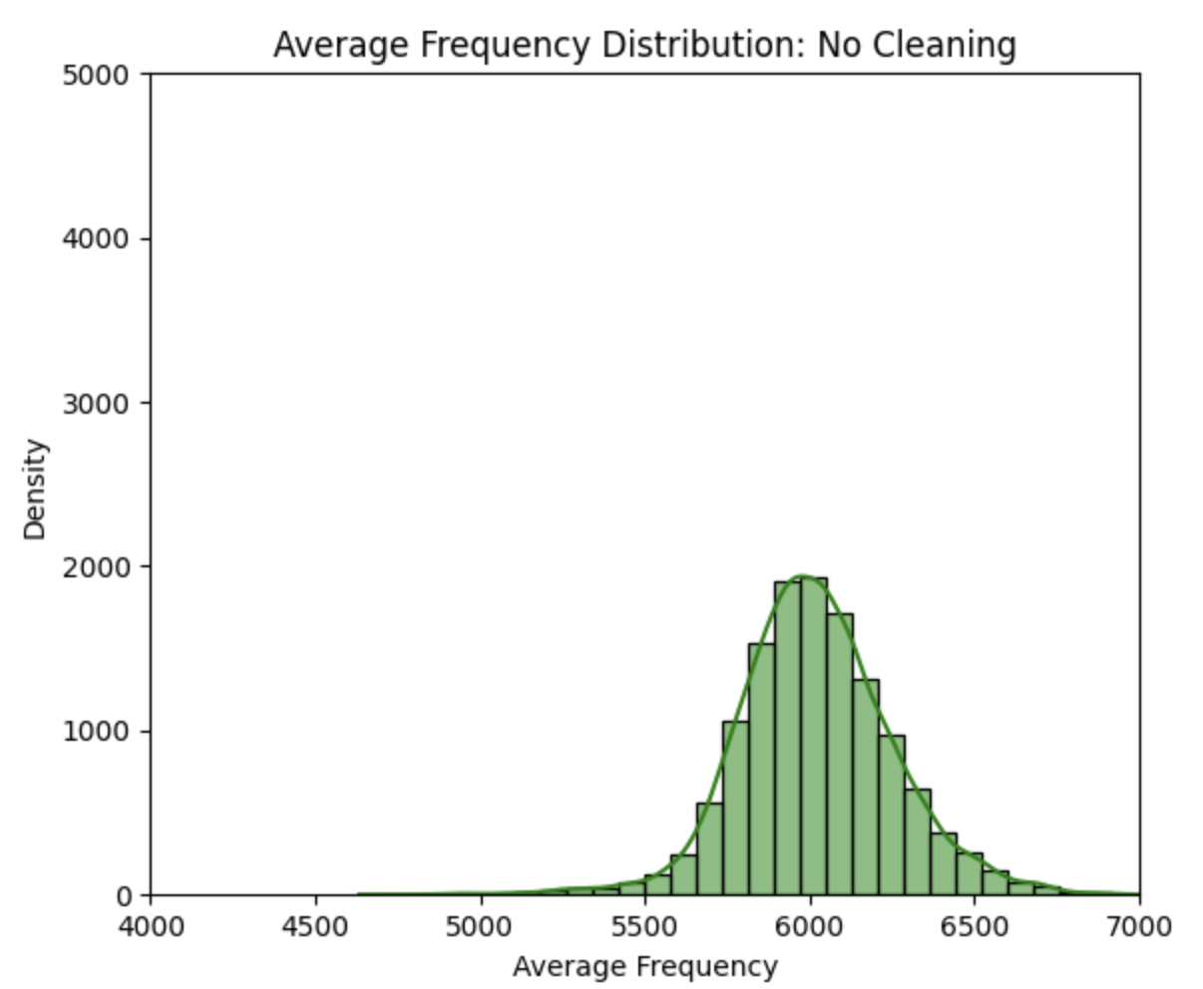
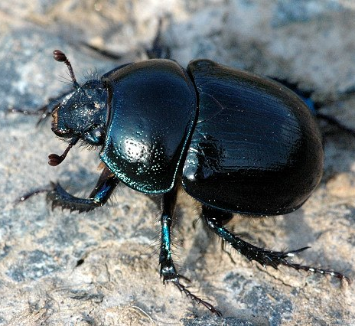
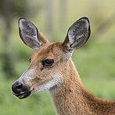
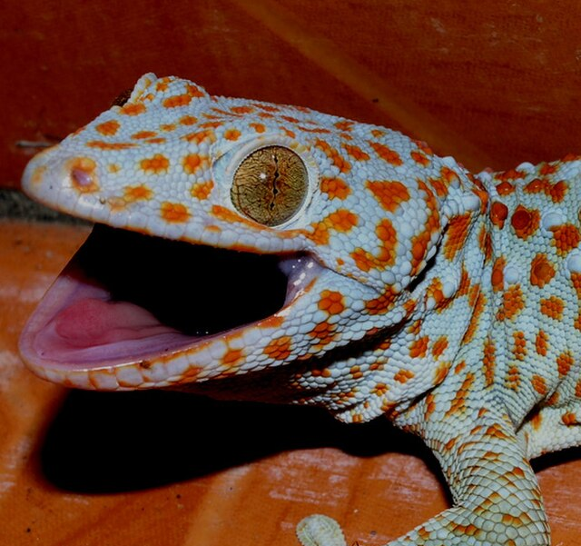
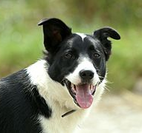
What our frogs sound like
Frog call frequencies:
Other species’ frequencies:
CC: James K. Lindsey
CC:
Jonathan Wilkins
70,000 Hz
2,700 Hz
CC:
Nick Hobgood
CC:
Ken Billington
3000 Hz
44 Hz
Notes:
Most of our calls have frequencies of around 6000 Hz. To improve our model’s accuracy, we wanted to train the model to detect non-frogs, so we selected a subset of species from the iNaturalist dataset which differed in frequency from our frogs and toads. Here are some examples of said species

Slide 15
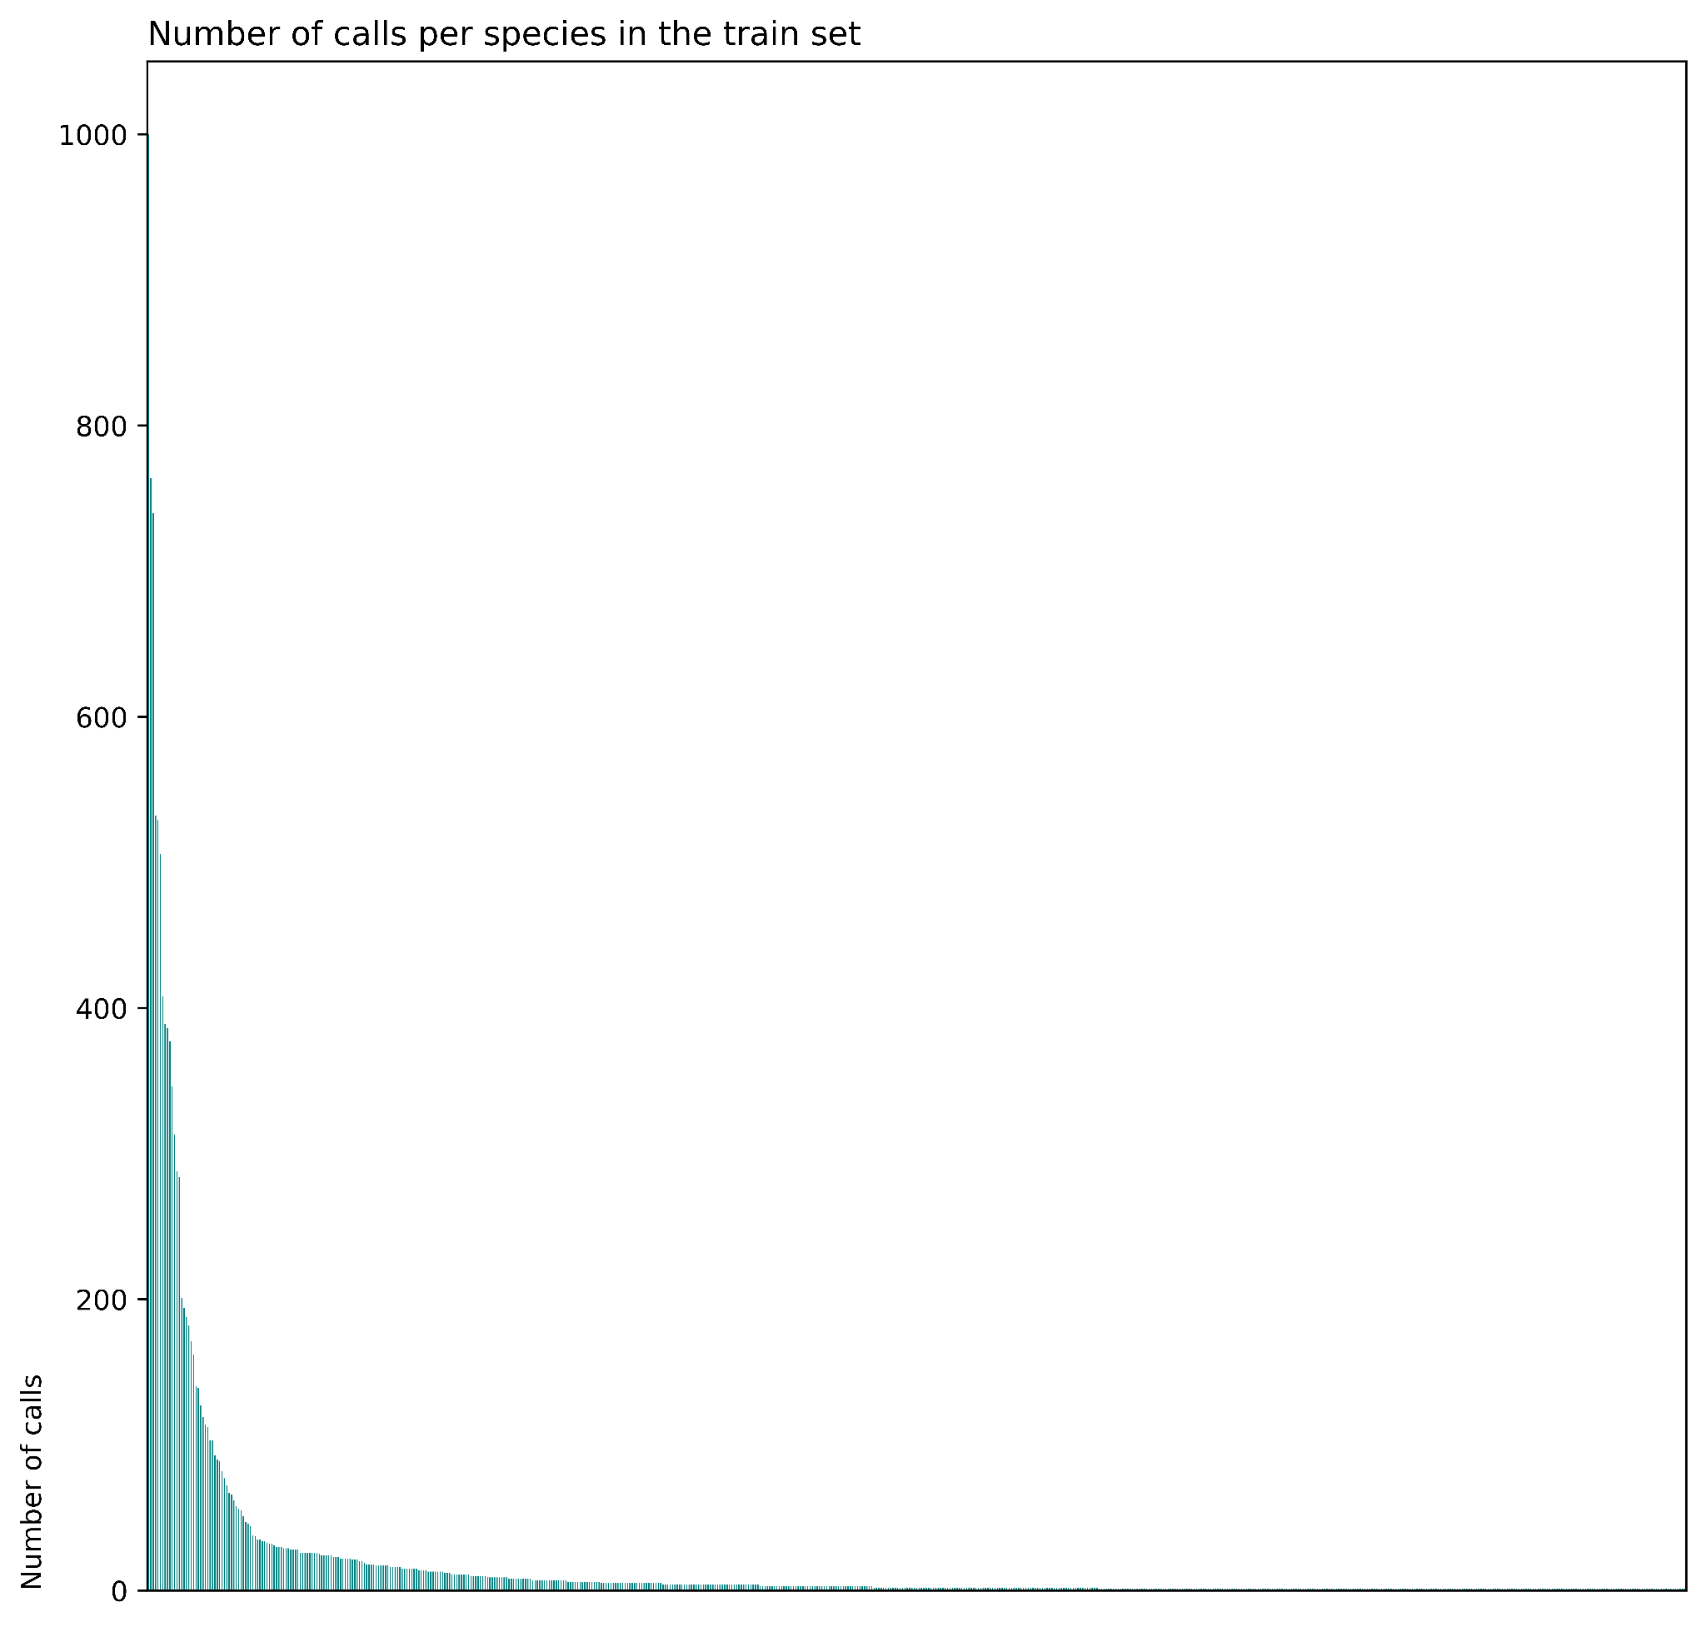
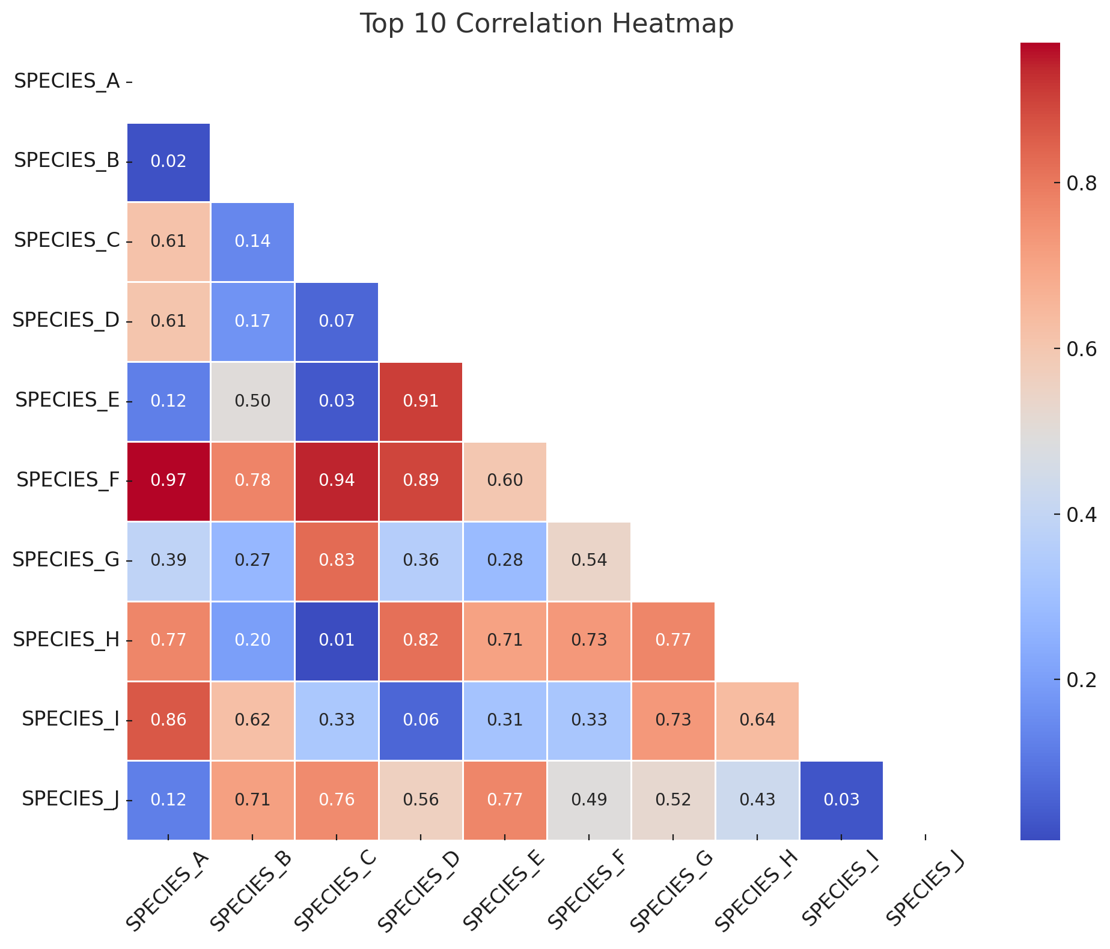
Strategies for our data
Our data is long-tailed FSL
Species co-occur Top 5 accuracy
Species B: 30%
Species C: 10%
Species D: 5%
Species E: 2%
Species F: 1%
Species F appears as one of the top 5 most likely species
Notes:
We came up with strategies for our complex data, such as deciding what to do with our rare species, since, as you can see, our data distribution is long-tailed. This makes our data a great candidate for using few-shot learning, Few-shot learning is a machine learning approach where a model learns to generalize from a very small number of labeled examples per class.
To deal with co-occurring species, which might lead to false positives, we decided to use top-5 accuracy, which will allow users to see the top 5 possibilities for their sound inputs.

Slide 16
04
Architecture

Slide 17
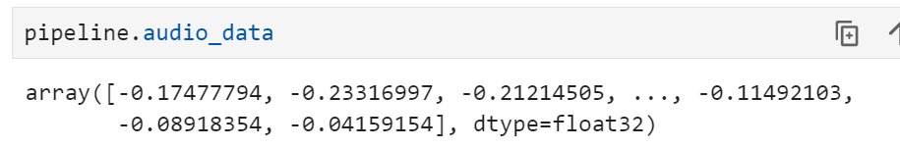
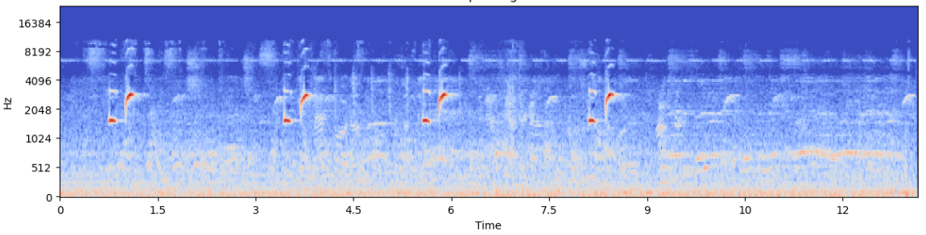
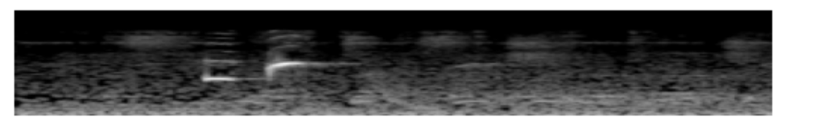
Data Pipeline
Cleaning & Trimming
Raw audio to pipeline
Trimming to 3 secs
Conversion to .wav
Cleaning background
Resampling 48kHz
Normalization
Single channel
Greyscale and Dimensions
Conversion
to np.array
Notes:
As discussed in previously, our pipeline starts off with the unprocessed audio file. Then we do some cleaning, being the basic steps:
Trimming into a 3-second segment.
Converting the trimmed audio into .wav format,
Cleaning background noise,
Resampling it to 48 kHz, and normalize the audio.
Converting the audio into a single channel,
Adjusting the dimensions and apply appropriate color mapping,
After that it's converted to NumPy array and that is our input.

Slide 18
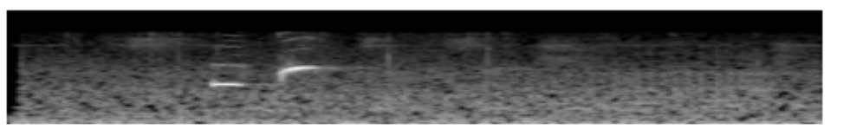
Data Augmentation
Cleaning & Trimming
Call following the standard pipeline
Call after augmentation
Conversion
to np.array
Notes:
As mentioned before for the species with a really low sample count we performed data augmentation, done by incorporating background noise from those non-interfering species.

Slide 19
Data Augmentation
Cleaning & Trimming
Call following the standard pipeline
Call after augmentation
Conversion
to np.array
Notes:
The augmentation can be noticed on the spectrogram above, where there’s a very dark / black areas, now have a slight cover over them, but the call is still well defined. We also applied windowing technique to the non-anuran calls, by cropping original files into segments of 3 secs, with a maximum of 1-second overlap in between them

Slide 20

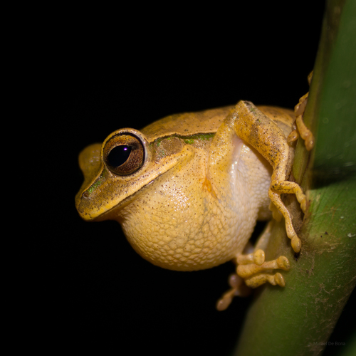
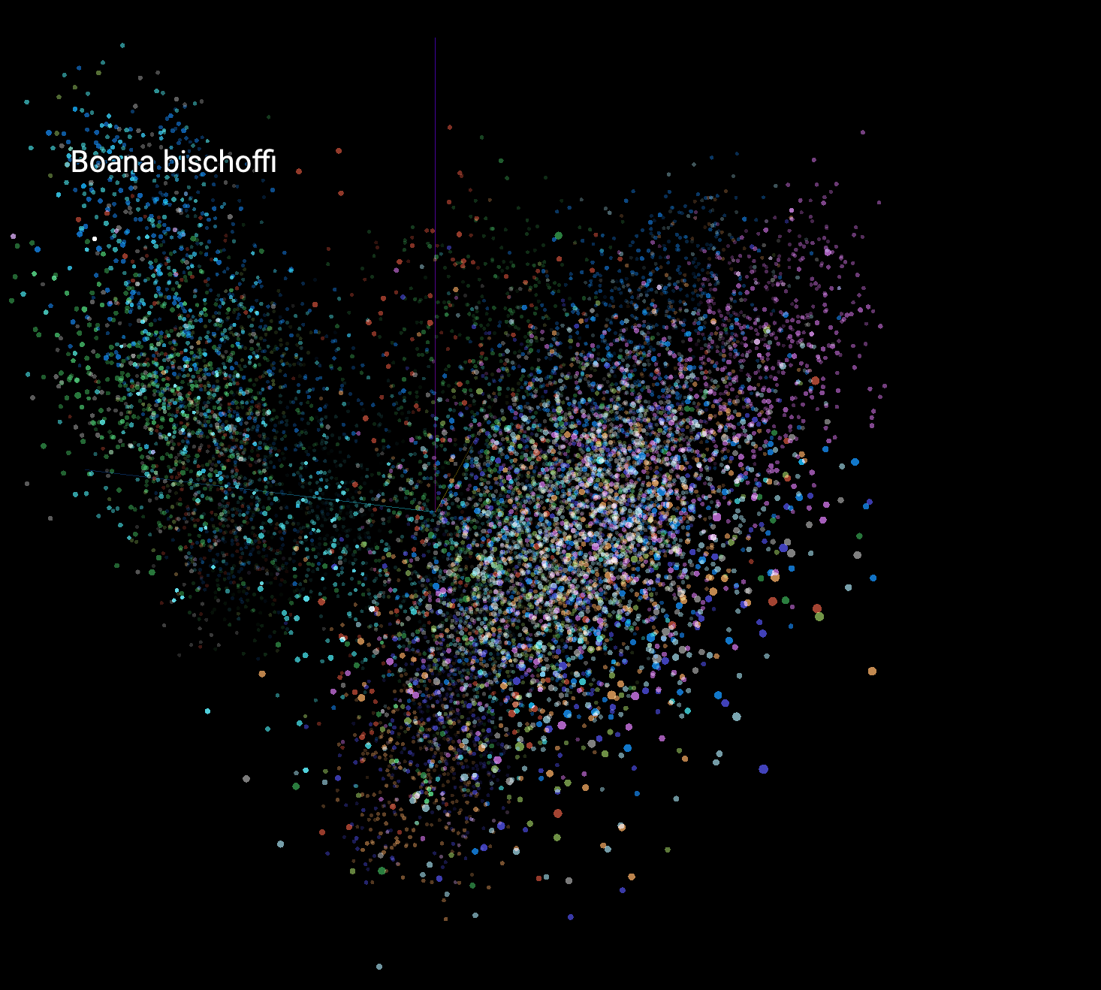
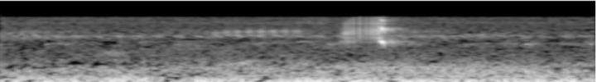
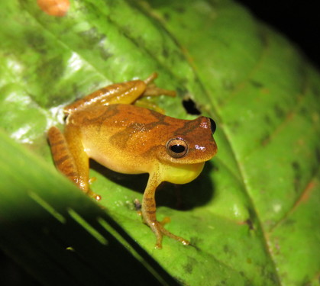
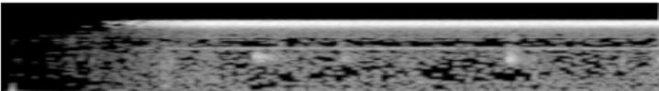

Embedding space
iNaturalist Sample
Anuraset Sample
(c) Micael De Bona – (CC BY-NC)
Dendropsophus minutus
iNaturalist Sample
(c) Vincent A. Vos – (CC BY)
Anuraset Sample
Created with https://projector.tensorflow.org/
Notes:
After extracting our embeddings for the species used in our baseline models, we plotted their PCA representation, and noticed that some species were more clustered than others. We identified two large clusters, representing each of our datasets.

Slide 21
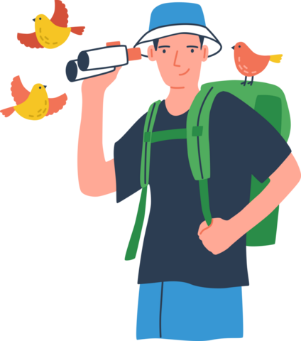
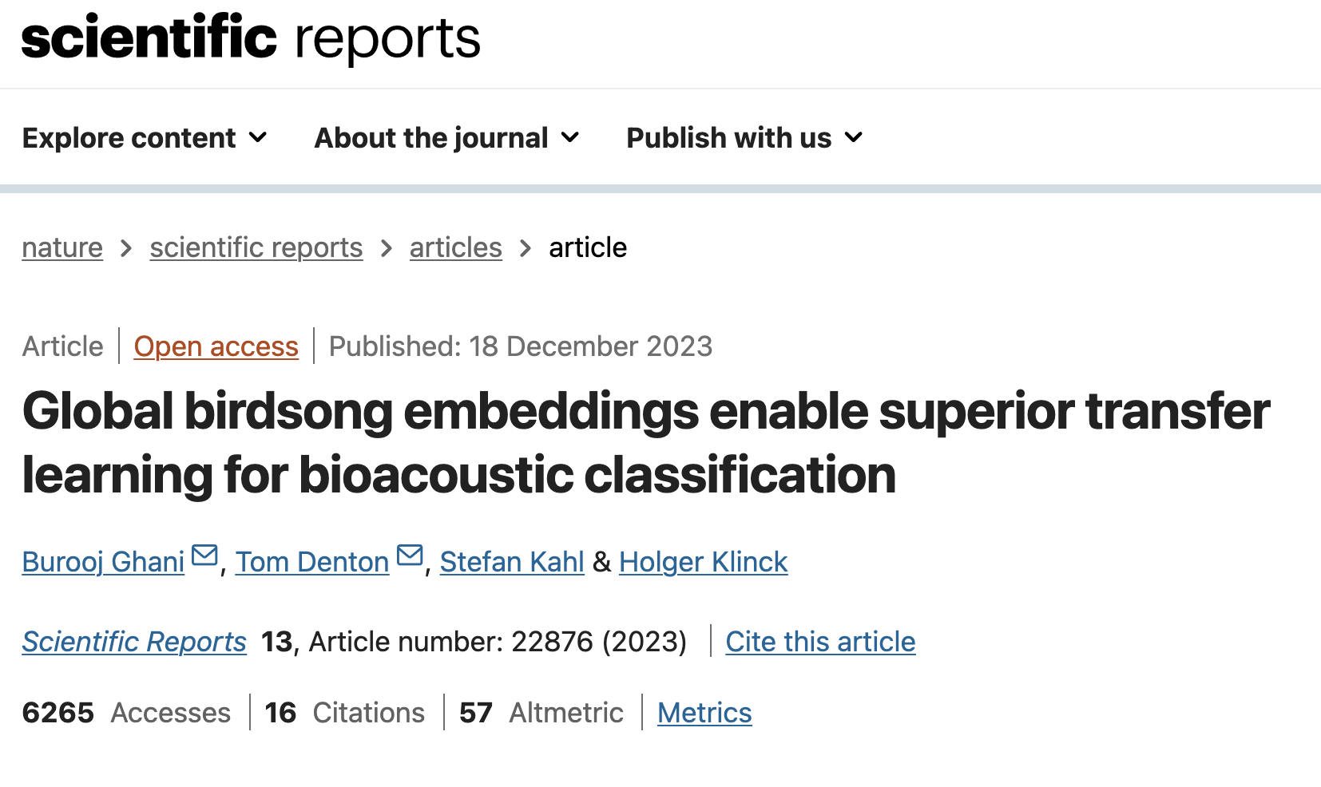
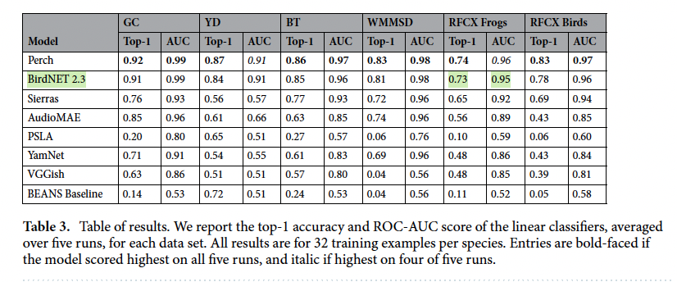
Baseline - BirdNET
Images taken from: https://www.nature.com/articles/s41598-023-49989-z
Notes:
Since our embeddings were extracted using the BirdNet model, we used its performance on frogs as our baseline model, as highlighted in the green rectangle on the bottom right.
We then experimented with 18 of our own models.
—----------
18 models include combinations of vanilla/FSL models and type of embeddings, and type of output.

Slide 22
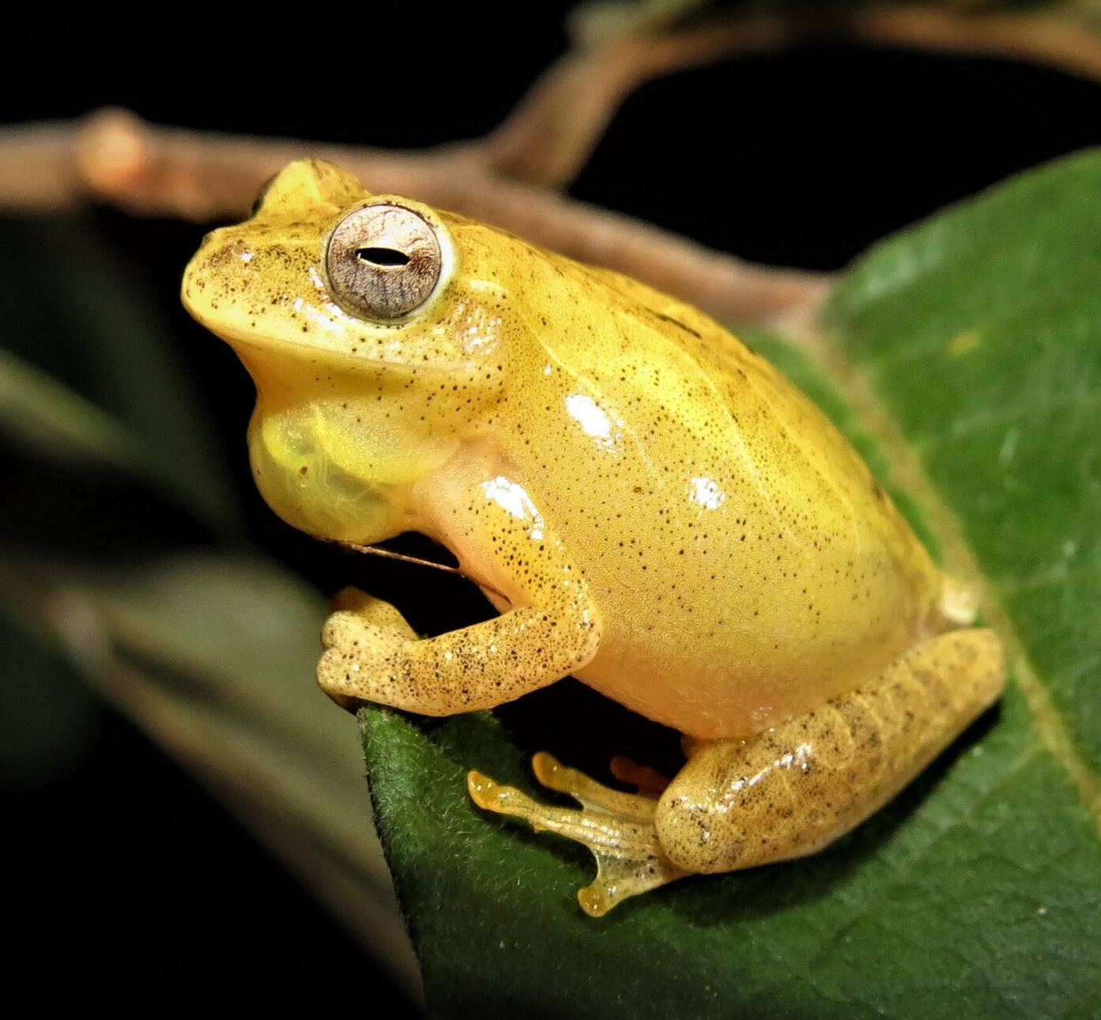
Experiments
Binary Classification
Species Classification
Family Classification
Reuber Brandão CC
CC: James K. Lindsey
Reuber Brandão CC
Reuber Brandão CC
Frog
Non-frog
Golden tree-frog
Tree frog
Embeddings
BirdNet model
Mel Spectrogram
Data preprocessing
Audio recording
Notes:
We experimented with the three different outputs shown here:
Predicting whether the species was a frog
The name of the species
and the family of the species.
We’ll now discuss our best-performing models.

Slide 23
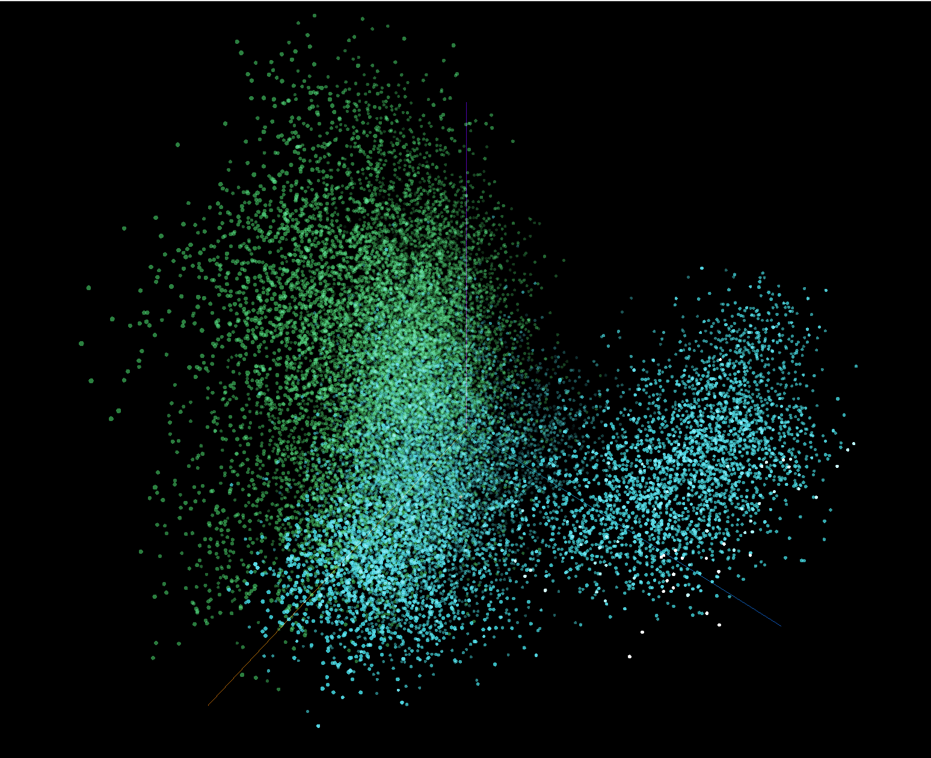
Species binary
Binary Classification
Non-frog
Reuber Brandão CC
CC: James K. Lindsey
Frog
Non-frog
PCA
iNat sounds
Anuraset
Embeddings
BirdNet model
Mel Spectrogram
Data preprocessing
Audio recording
Notes:
We ran a few binary classification models to decipher frog vs non frog.
We encountered many issues with the binary classification.
The main issue was that the features extracted from the frog and non-frog data are not sufficiently distinct in the embedding space, making it difficult for the model to classify them accurately.
And we think this happened during data augmentation when the resulting augmented sounds might have inadvertently become more similar to non-frog sounds ultimately making it harder for the model to distinguish between frog and non frog, as seen on the image on the top right, which represents our frog and non-frog embeddings, and where they overlap.The next step would be to redo the augmentation process to ensure minimal overlap between both frog/non-frog

Slide 24
Species multiclass
Best-performing model: FSL
top - 5 accuracy: 91%
top - 1 accuracy: 72%
ROC AUC: 96%
Species Classification
Reuber Brandão CC
BirdNet top-1 accuracy on frogs: 73%
Golden tree-frog
Embeddings
BirdNet model
Mel Spectrogram
Data preprocessing
Audio recording
Notes:
For our multi class species level model, the FSL model on 71 species was the best performing one with a top 5 accuracy of 91% which as we mentioned means that the correct species was included in one of the 5 species to the users, and a top 1 accuracy of 72%. Since BirdNet was our baseline model with a top-1 accuracy of 73%, we are pretty happy with our results, especially since outputting the top 5 species greatly improved the accuracy.

Slide 25
Family multiclass
Best-performing model: FSL
top - 5 accuracy: 95%
top- 1 accuracy: 68%
ROC AUC: 95%
Family Classification
Reuber Brandão CC
Tree frog
Embeddings
BirdNet model
Mel Spectrogram
Data preprocessing
Audio recording
Notes:
Finally, we have our family level multiclass model, whose purpose was to predict the family of the frog, rather than the species. Our best performing model was our FSL one using 23 families, which had a top 5 accuracy of 95%.

Slide 26
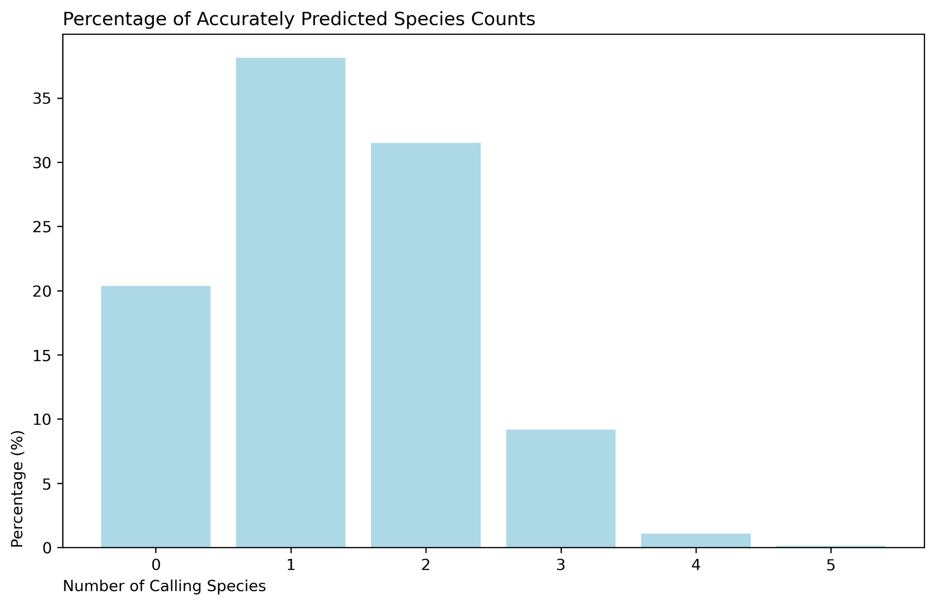
Best-performing model
FSL Multiclass Species Model (71 Species)
Top 5 Accuracy: 91%
Notes:
While our multi-class family model had a slightly higher top 5 accuracy, we prioritized species level identification, so our best performing model was the few shot learning model on 71 species. And as a reminder this had a top 5 accuracy of 91%. We also found that this model was able to correctly identify multiple species if more than one were calling as you can see in the bar graph on the screen.

Slide 27
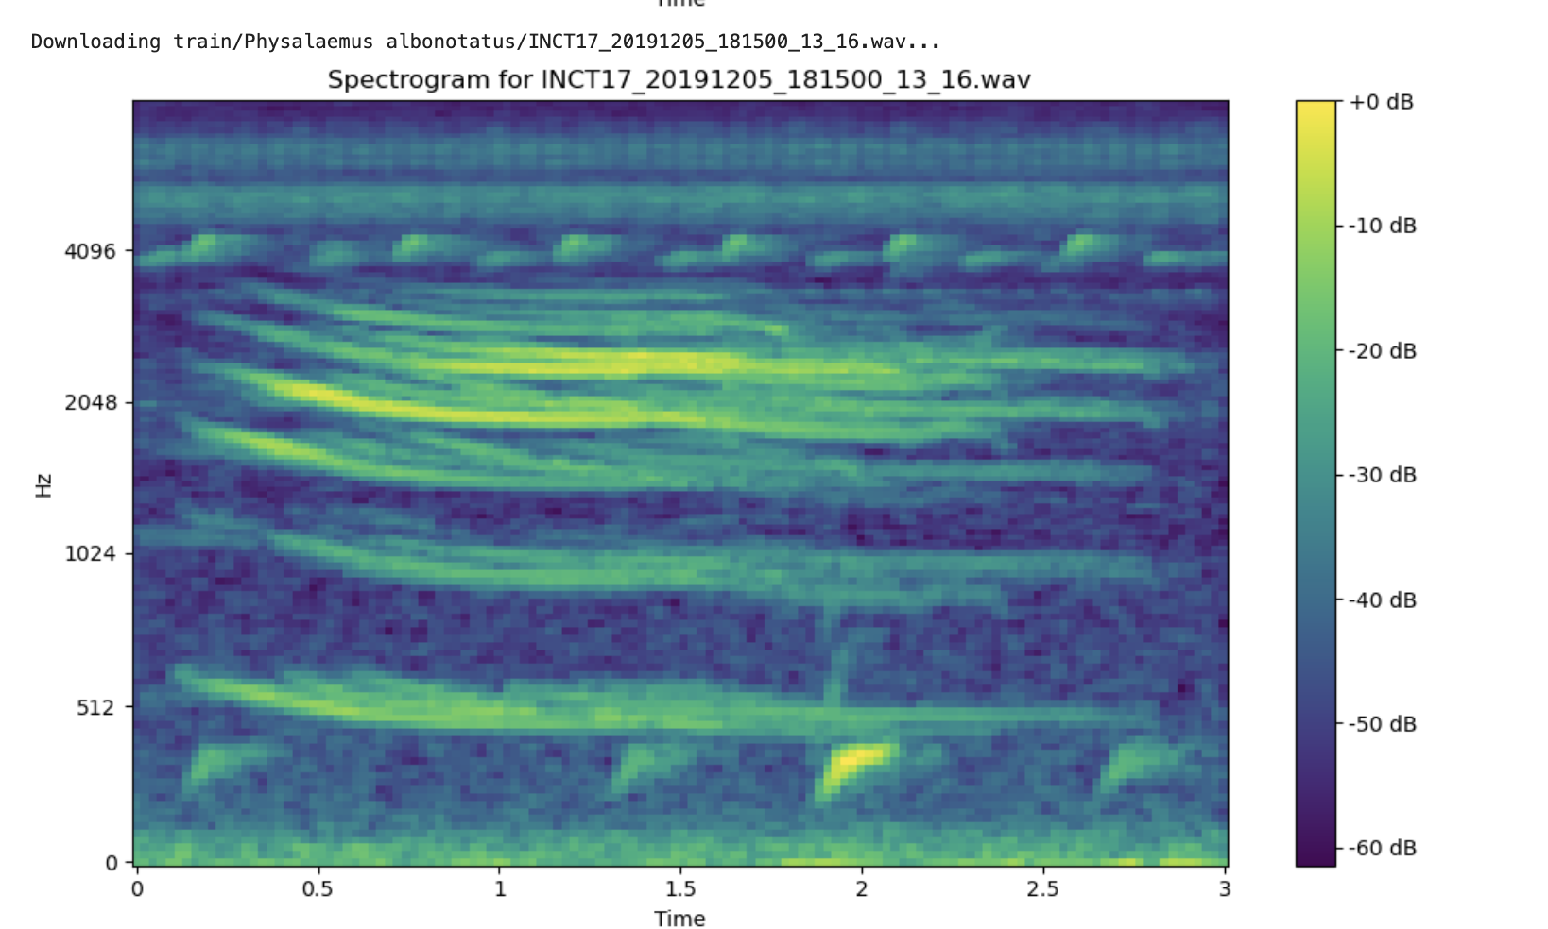
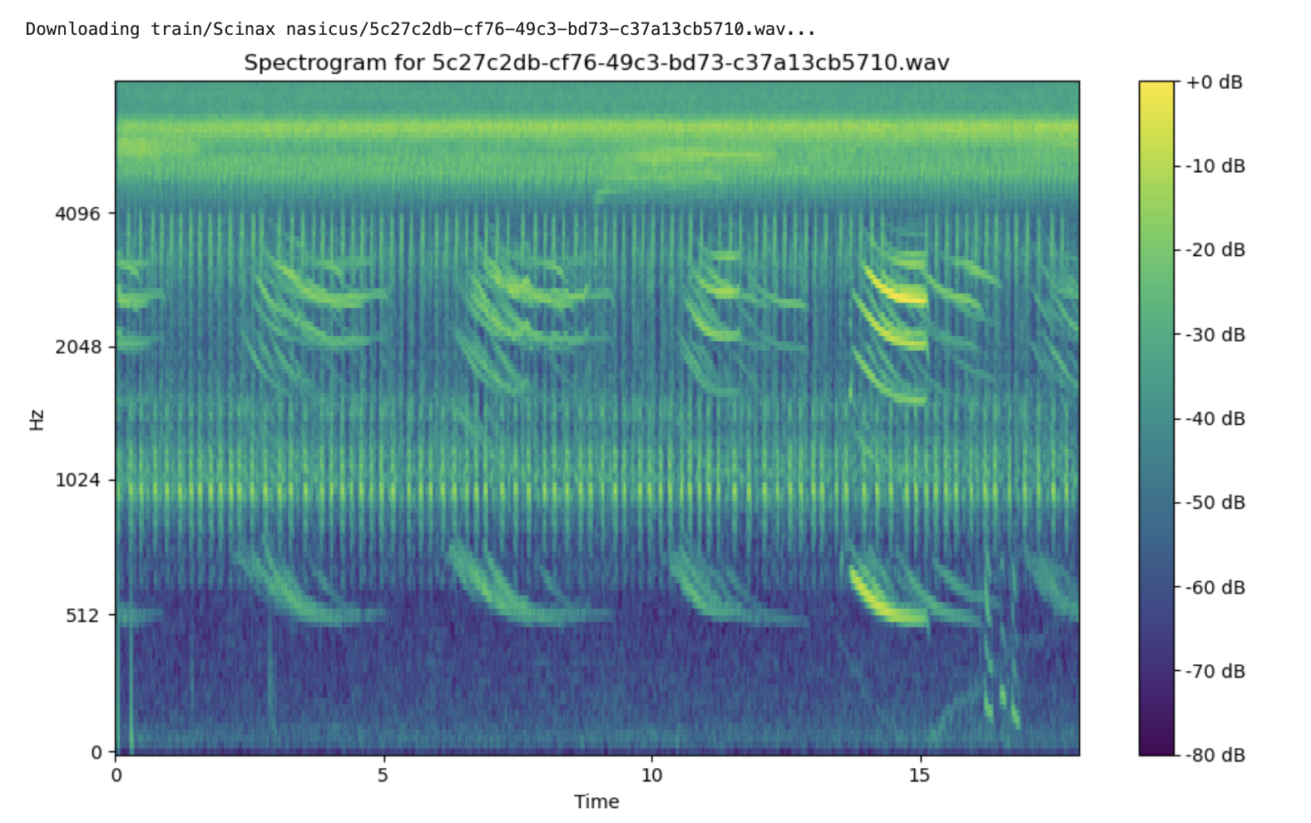
Confused Species
Physalaemus albonotatus
Scinax nasicus
Notes:
We wanted to look into our model some more and while our model performed pretty well, we did notice some easily confused species like Farouk mentioned earlier. On the screen is an example of a spectrogram from two different species and we can also listen to their calls as well. You can tell that they do not really sound the same to our ears so we looked into it a little more and found that there were some audio files that contained both of these species together so the model may not have known which one to predict or the model is picking up on some features that may be invisible to our ears. In the spectrograms, you can see that they both have a similar pattern with that horizontal line/swoosh going across which could be making it difficult for the model to distinguish between these two species. So because of cases like this, we decided to go with the top-5 accuracy rather than the top-1 for model evaluation

Slide 28
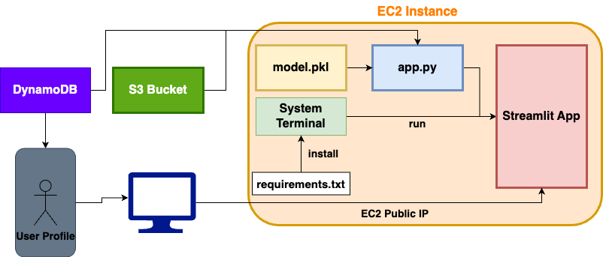
Cloud-based Infrastructure
Notes:
User Interaction:
Starting on the left, the user accesses the app through their browser, which interacts with a Streamlit app hosted on an EC2 instance.
EC2 Instance Setup:
Within the EC2 instance, we have three primary components:
App Code: This is our Streamlit app code, which drives the user interface and manages interactions.
Model File: Our pre-trained machine learning model for frog sound classification, loaded by the app to predict species.
System Terminal: Used to install dependencies and setting up the environment
Data Storage and Metadata:
S3 Bucket: Acts as storage for user recordings
DynamoDB: Serves as our metadata database
Networking:
The EC2 instance has a public IP that allows users to access the Streamlit app from anywhere. All interactions, like audio uploads and predictions, happen in real-time via this connection.

Slide 29
05
Key takeaways

Slide 30
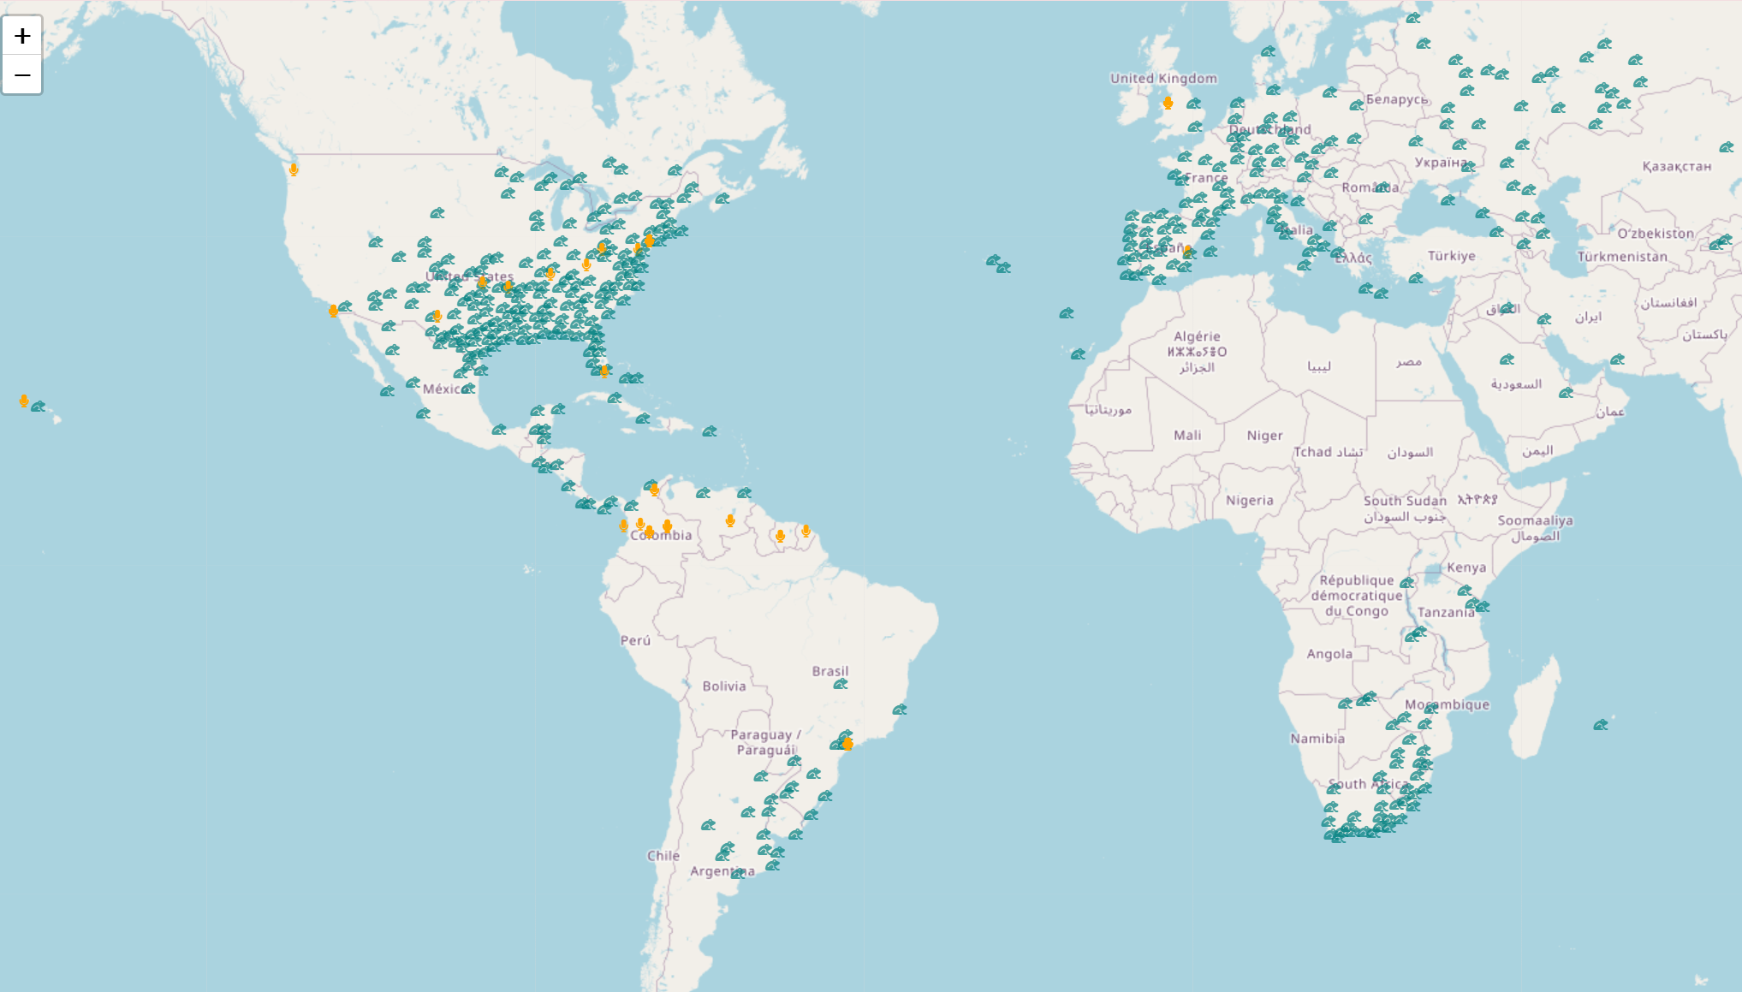


Ribbitback
User feedback on our webapp
Beta-tester’s recordings
Training recordings
Notes:
Ribbit is catching every fly!
In yellow you can see our user data, with a great kick off in terms of location diversity.

Slide 31
Ribbitback
User feedback on our webapp
New Features
It would be wonderful to see where in the world my recordings were taken or where in the world the Frog of the Day or the Explore Frogs are
I'd love a way to add notes to my recordings.
I liked the scientific detailing of each frog; however, I believe it would be interesting to include the common name of each frog/how it is known or where it is found.
Notes:
As far as feedback, users seem to be positive with a great of room for improvement! For now, some of the top requests for new features were:
Map feature to help with the visualization of species distribution
Addition of user notes to the user’s recordings and
Addition of the Common Names for our species

Slide 32
Ribbitback
Hello Ribbit creators,
I want to congratulate you on the development of Ribbit. I am a biodiversity scientist working in Colombia, and have had the opportunity of witnessing first hand the impact that eBird has had for the monitoring, and the social appropriation of birds in Colombia and people always ask… why only birds? My answer is usually because they are the easiest for non-scientists to encounter and identify but through apps like Ribbit this does not need to be the case for ever!
Relying on sounds for identification, which are a lot easier to record with a regular phone vs trying to take an actual picture of a frog on the wild, is an excellent idea and just like it happened with eBird, the more that people use the app, the better the information it will provide. A question as “simple” as what species live where/when is still a challenge in megadiverse countries like Colombia, so all data generated by Ribbit will be useful in meeting this challenge.
Keep working hard and let us know if we can help in any way
Lina M Sánchez-Clavijo, PhD
Principal Researcher
Scientific Information Office
Instituto Humboldt
Notes:
We were also thrilled to receive feedback from a highly esteemed subject matter expert, Lina Sanchez, the Principal Researcher at the Scientific Information Office of the Humboldt Institute in Colombia.
Lina emphasized the significance of initiatives like Ribbit for advancing biodiversity monitoring, specially in megadiverse countries such as Colombia, even drawing a comparison between our web app and the industry peer eBird.
Needless to say, we were delighted by her kind words and feel a great sense of fulfillment as we draw closer to achieving our mission.

Slide 33
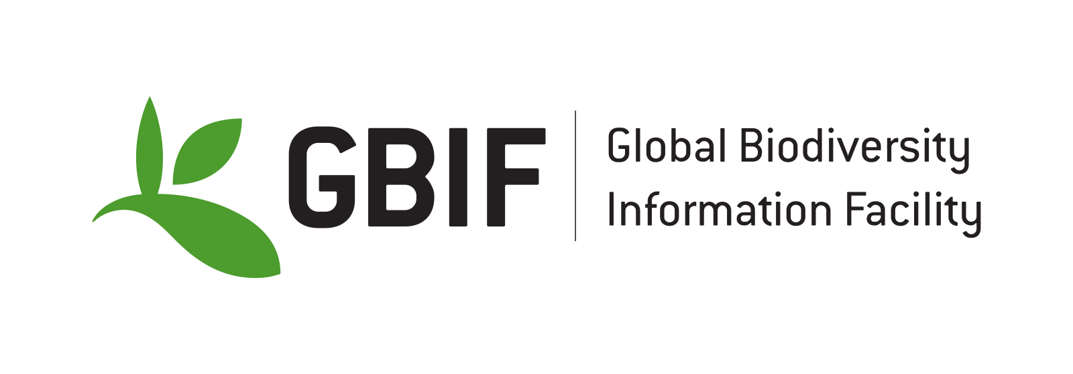

Roadmap
Include species distribution map
Share recordings
Procure funding
Notes:
This is our road map which highlights some general features for us to add in our next in order to make our application more robust and useful in accordance with our mission.
We’re currently including the species distribution, that is, where our species are located, to make the model more robust.
We need to upload our data to the Global Biodiversity Information Facility which is is an international network and data infrastructure funded by the world's governments and aimed at providing anyone, anywhere, open access to data about all types of life on Earth.
We have decided to keep the project going after Capstone, as a start up, which is why we’re procuring funding. We just applied for the tech4nature award, but if you’re interested in participating, feel free to reach out.

Slide 34
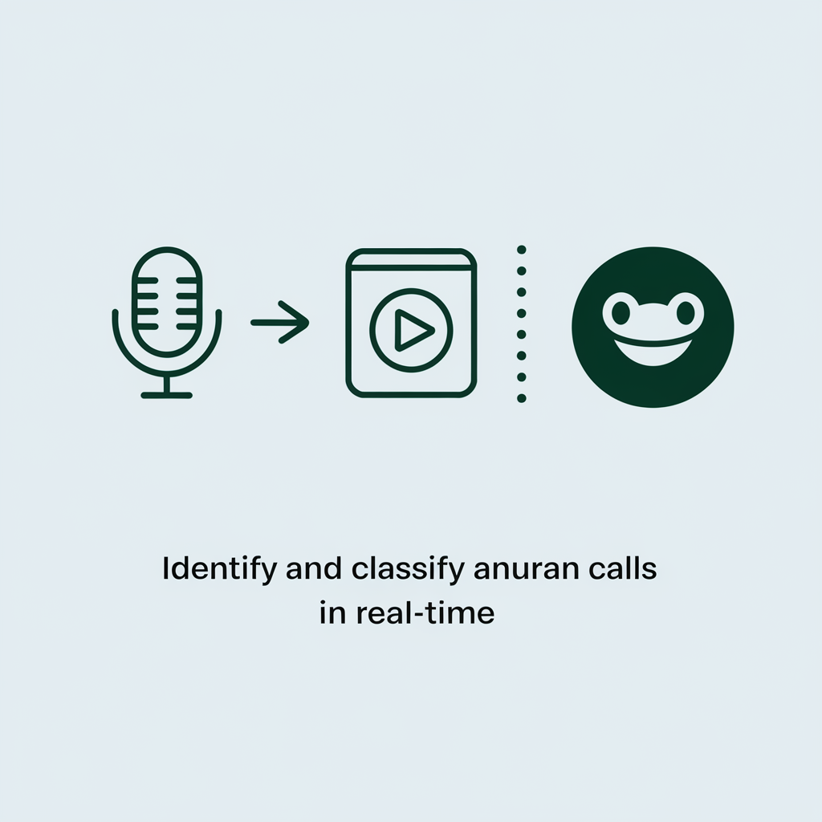
Our Mission
To bridge the data gap in biodiversity by harnessing machine learning for real-time identification of frog calls. We are committed to developing a web application that enables nature enthusiasts to record, identify, and classify frog calls.
v
Notes:
As a reminder, our mission is to:
To bridge the data gap in biodiversity by harnessing machine learning for real-time identification of frog calls.
We are committed to developing a web application that enables nature enthusiasts to record, identify, and classify frog calls.

Slide 35

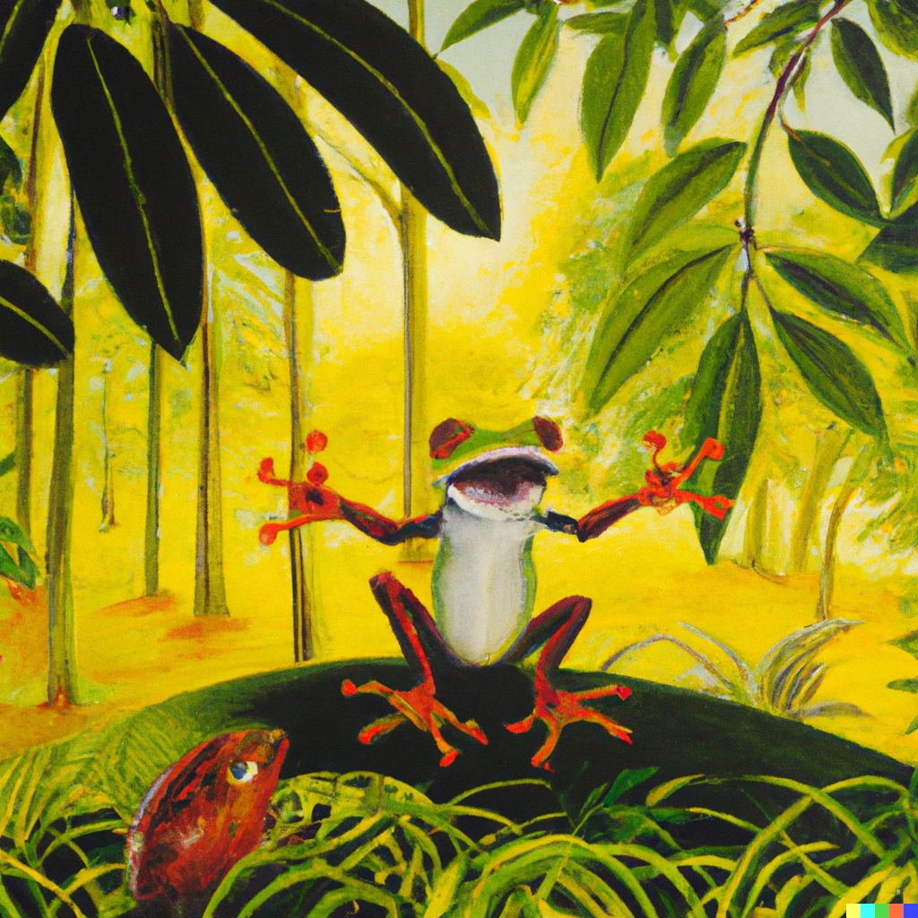

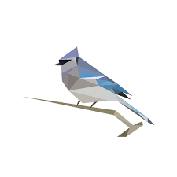


Acknowledgements
Dr. J. Nicolás Urbina
Dr. Santiago Ron
Dr. Juan Sebastián Ulloa
Juan Sebastián Cañas
Dr. Jodi Rowley
Dr. Stefan Kahl
Dr. Matthew McKown
…..and to all of our beta testers
For more information, visit: https://ribbit.edi.eco/

